Slide 1

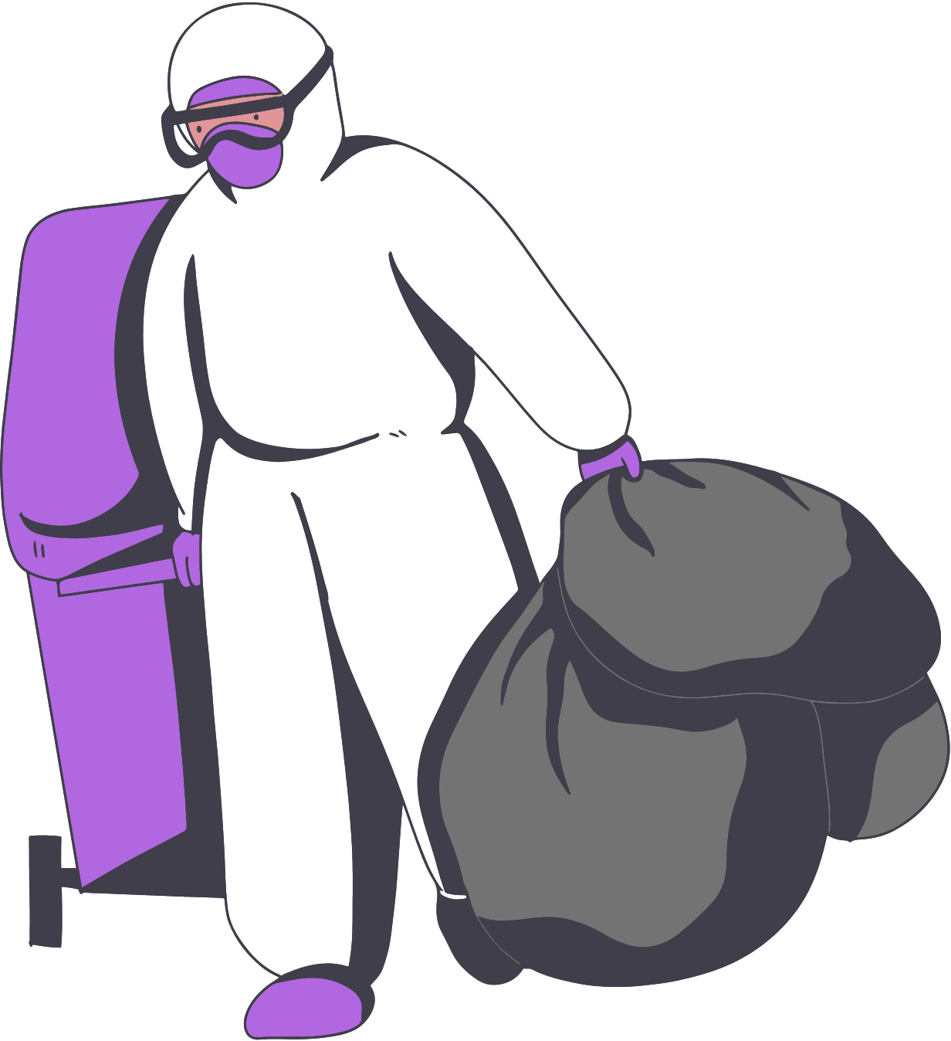

Biomedical waste disposal
A SUSTAINABLE ALTERNATIVE
TEAM MEMBERS:
DURGA R (200301017)
MANESAA VJS (200301045)
A INNOVATIVE FOR A MORE SUSTAINABLE ENVIRONMENT

Slide 2

Our aim is to eradicate the increasing environmental hazards caused by the bio medical wastes by converting them into conventional bricks.
MISSION

Slide 3


MOTIVATION
MOTIVATION
SOLUTION
The increase in PPE kits, masks, face shields and other protective gear during COVID has cased and exponential increase in hospital waste disposal in landfills. Similiarly the brick klins on an average emit 2.3% of all particulate matter hence causing an increase in pollution.
Incorporation of cleansed biomedical wastes from hospitals in preparation of bricks for construction will a major step towards prevention of environmental pollution and spread of infection due to dumping the waste in landfills. The will be a more cost effective way and can also help the economically weaker sections of the society.

Slide 4
MAY'20
20
JUNE'20
110
MAY'21
203
JULY'20
150
APR'21
155
AMOUNT OF BIOMEDICAL WASTE DISPOSED DURING COVID
AUG'20
175
MAR'21
75
FEB'21
50
JAN'21
75
SEP'20
183
DEC'20
155
OCT'20
179
NOV'20
160

Slide 5

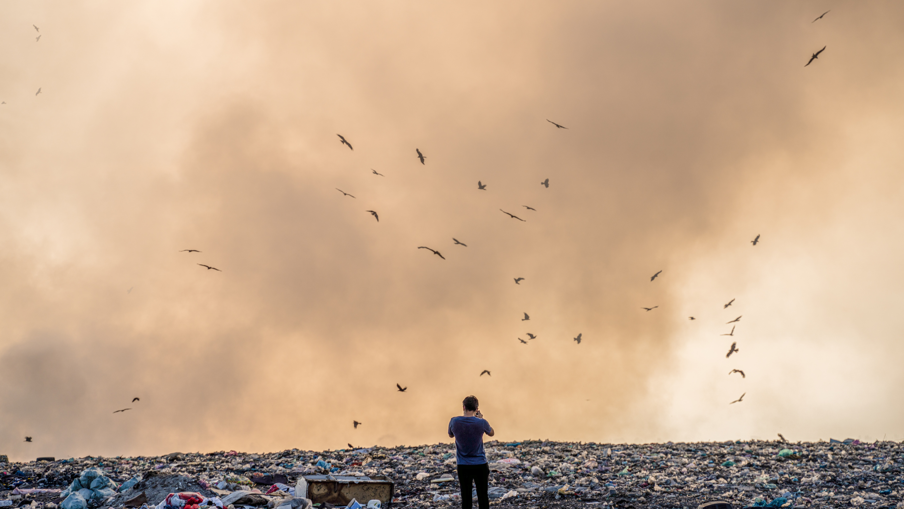
754 tonnes
of biomedical waste was produced per day according to CPCB's analysis in May 2021

Slide 6

METHODOLOGY
01
02
03
04
05
Biomedical waste collection from hospitals
Sterilization of the waste in Autoclave (Steam sterilization)
Shredding the materials and separation of plastic from other fibers.
The fabric and the plastics are layered alternatively and is enclosed within a layer of cement and sand mixture.
The brick is left to set for 4-5 days and is ready to use.
We start here!

Slide 7

MARKET ANALYSIS
01
Present market rate for conventional bricks
₹ 8 per piece
02
Present market rate for Papercrete bricks
₹ 4.75 per piece
03
PPE bricks
Our bricks are primarily sourced from medical waste hence the cost of raw materials would decrease exponentially. Hence we estimate a futher decrease in the cost per brick.

Slide 8
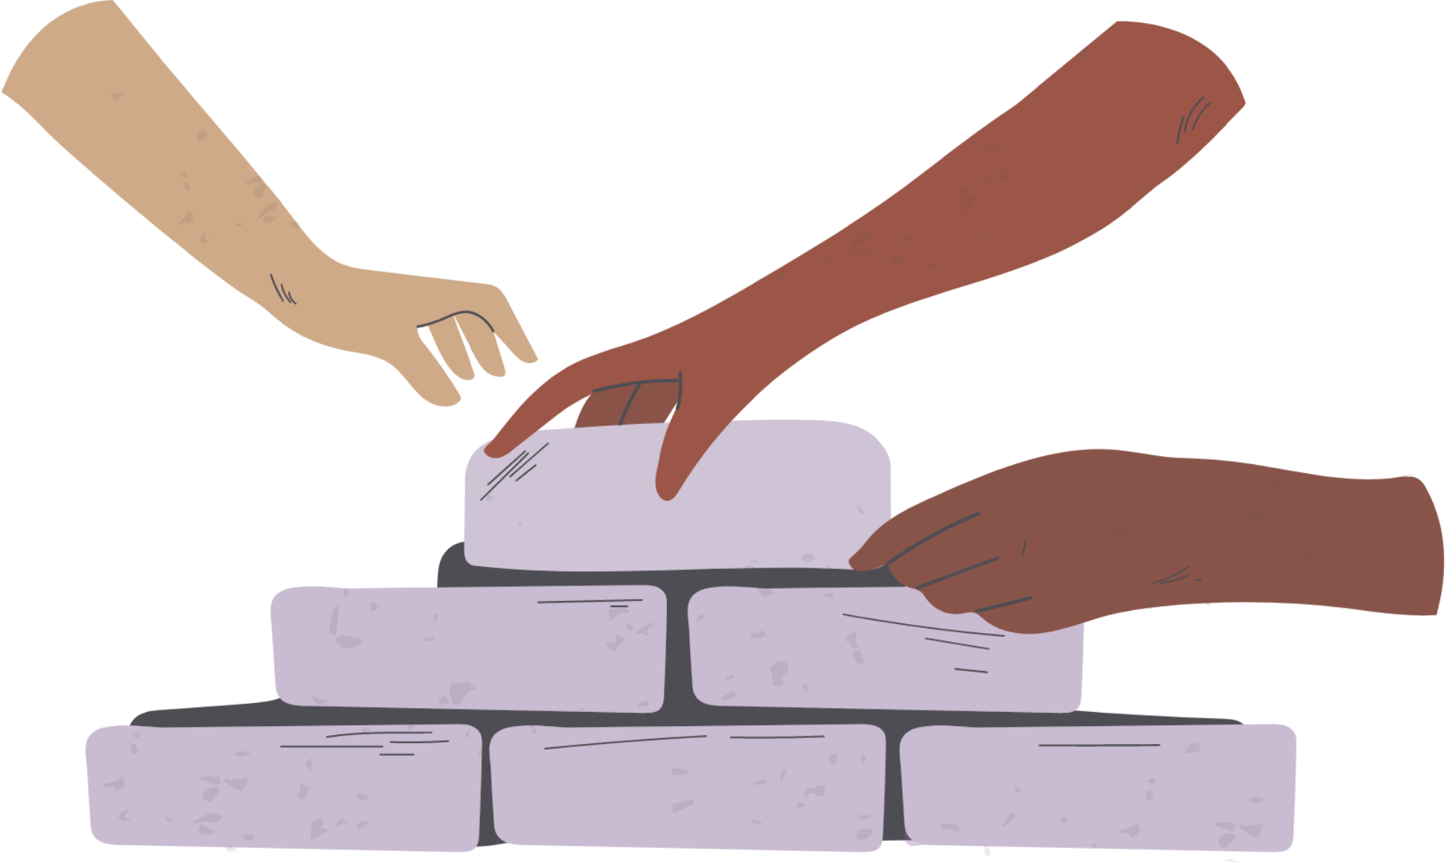
CONCLUSION
This innovation not only solves the Environmental issues but also helps people in disaster prone zones and poverty line to have an cheaper alternative to construct their buildings with.

Slide 9

THANK
YOU

